Slide 1
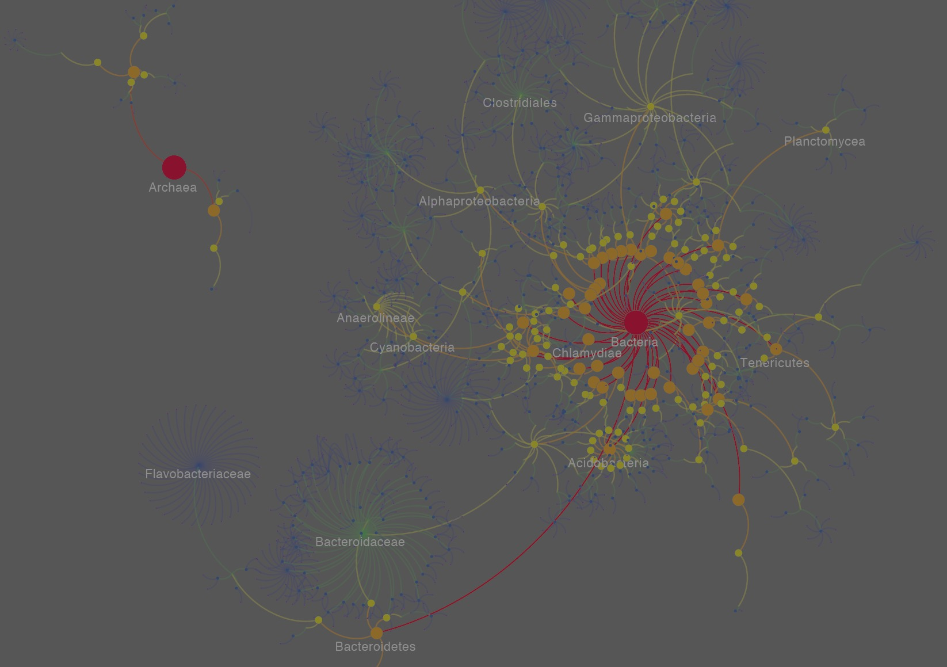
Network biology
Sergio Baranzini, PhD

Slide 2
Examples of network biology
Genetic
Co-expression
Protein interaction
Metabolic
TF binding
Phosphorylation

Slide 3
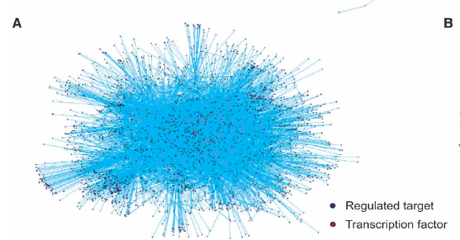
TF binding net

Slide 4
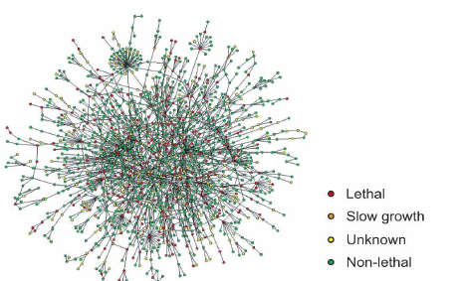
Protein interaction net

Slide 5
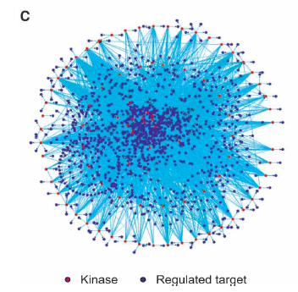
Phosphorylation net

Slide 6
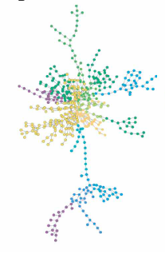
Metabolic net

Slide 7
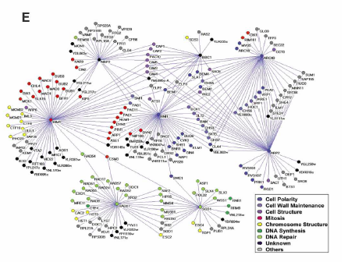
Genetic (synthetic lethality)

Slide 8
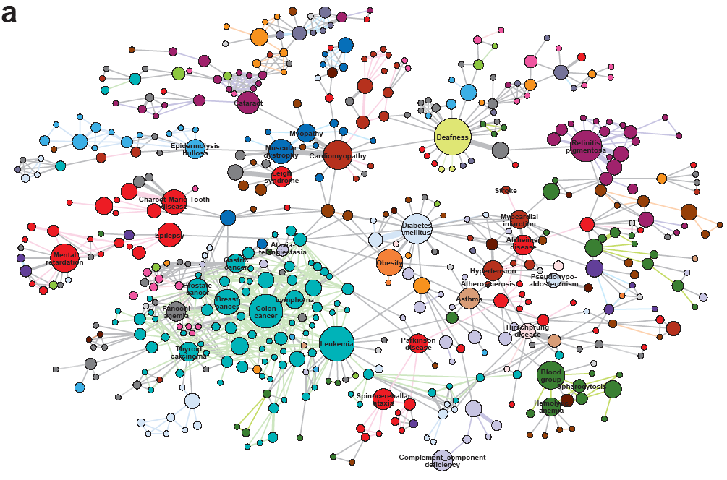
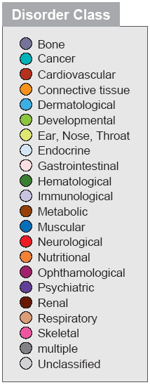
Bi-partite nets: The diseasome
Proc Natl Acad Sci U S A. 2007 May 22;104(21):8685-90

Slide 9
Other bi-partite nets
Drug target net (Yildirim et al. Nat Biotechnol. 2007 Oct;25(10):1119-26.)
Drug interactions (Campillos et al. Science. 2008 Jul 11;321(5886):263-6)
Drug repositioning (Keiser et al. Nature. 2009 Nov 12; 462(7270):175-81.)
Disease-symptoms (Zhou et al. Nat Commun. 2014 Jun 26;5:4212. )

Slide 10
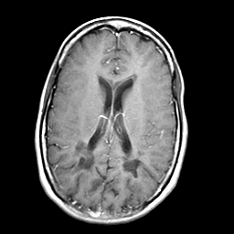
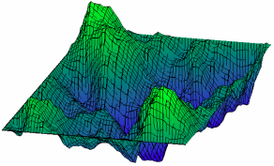
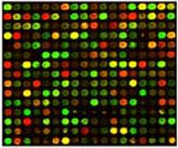
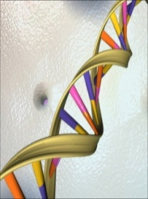
Hierarchical organization of biological complexity
Physiological/pathological
Process (health/disease)
high
neurodegenerative
metabolic
autoimmunity
cancer
infectious
Cell cycle
apoptosis
Cellular
process
Cell differentiation
pathways
proteins
low
Phenotype
expression
Genotype
genomic
metagenomic
Notes:
Hierarchical organization of complex organisms. (arrow depict the direct and indirect relationships across different levels)
Several different datasets are available at different levels and it is generally difficult for any single individual to keep up with these new developments across many different specialties.
I believe that its integration is likely to produce important new knowledge no only in MS but also in other complex diseases.
Inferences can be made between different levels.
In genetic analysis, genotype is correlated with a higher order trait.
The more immediate the phenotype to the genotype, the most likely that association is causal. But it is less likely that that association is specific (gene expression is not specific to MS).
Linking MRI with MS is a compromise between a lower level phenotype (than the disease trait) (thus, more immediate to causation) and a high specificity for the disease trait.

Slide 11
First GWAS in multiple sclerosis (MS)
1000 cases

Slide 12
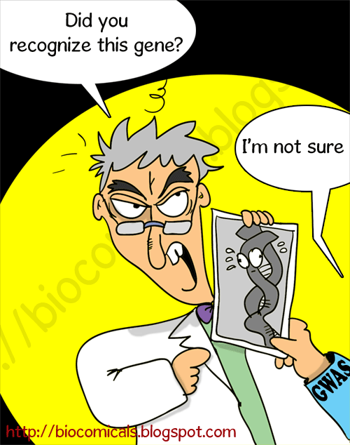
The problem

Slide 13
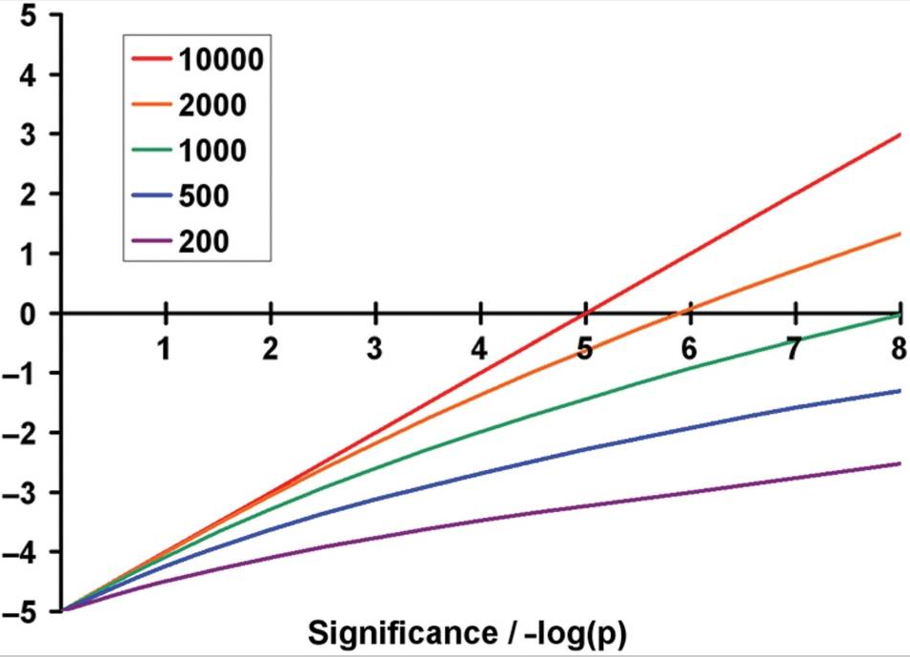
Posterior odds of GWAS associations
LOR
Sawcer SJ, Brain. 2008

Slide 14
Pathway A
Pathway B
Pathway C
Genes
1
2
3
4
5
6
7
8
9
10
11
12
13
14
15
16
17
18
19
20
21
22
23
24
25
26
27
28
29
30
31
32
33
34
35
36
37
38
39
40
Individuals
HLA

Slide 15
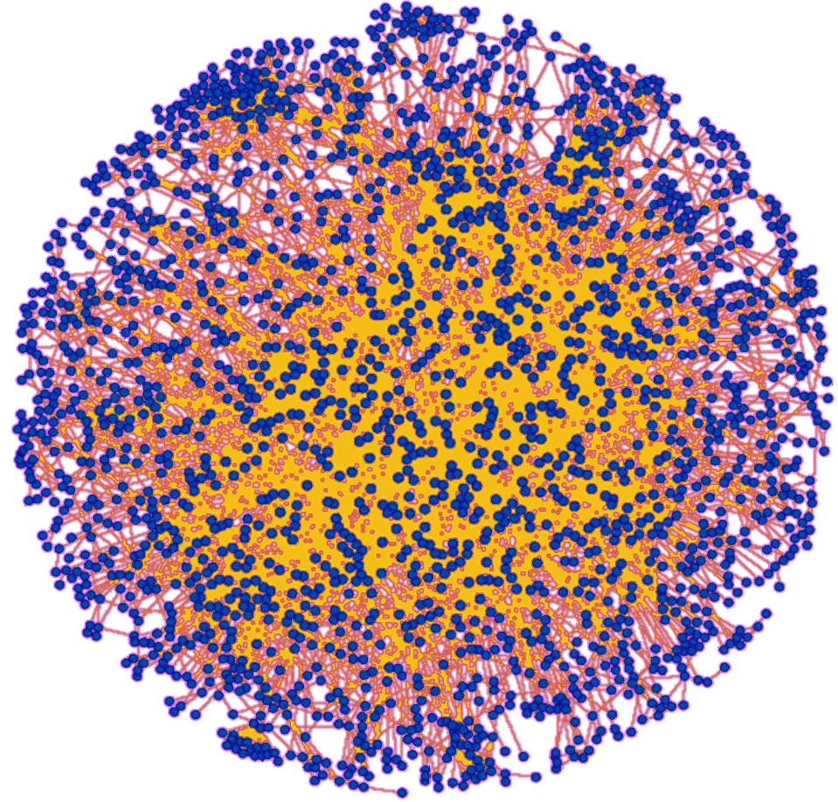
Hypothesis: Overlapping statistical evidence of association with physical evidence of interaction should discover modestly associated genes
Human protein interaction network

Slide 16
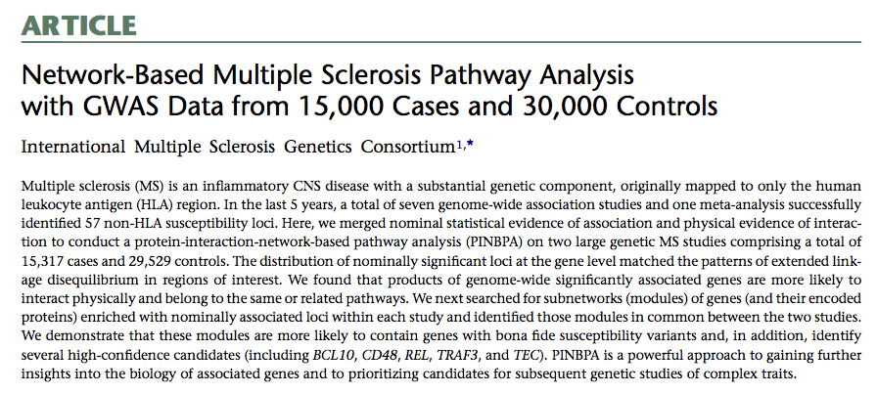

Slide 17
Heterogeneous networks (Daniel Himmelstein and Charlotte Nelson)

Slide 18
Imagine…

Slide 19
1,538 approved
small molecule compounds
136 complex diseases

Slide 20
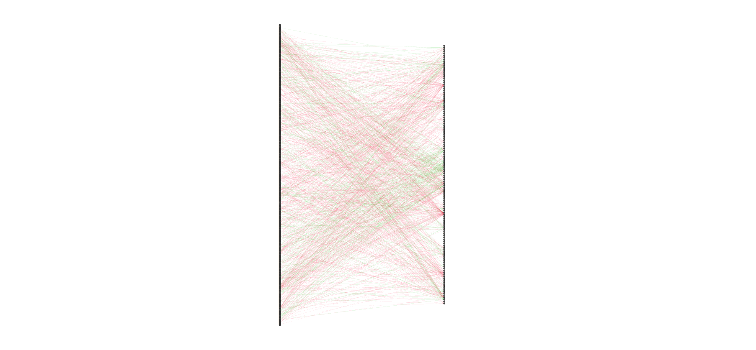

Slide 21
small
molecules
diseases

Slide 22
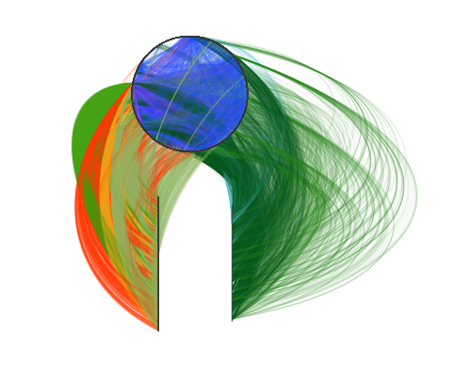
genes
small
molecules
diseases

Slide 23
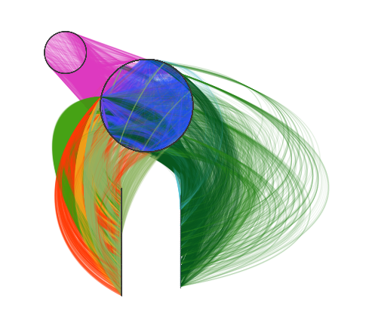
Molecular function
genes
small
molecules
diseases

Slide 24
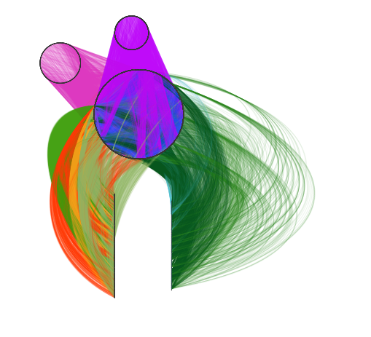
Biological process
Molecular function
genes
small
molecules
diseases

Slide 25
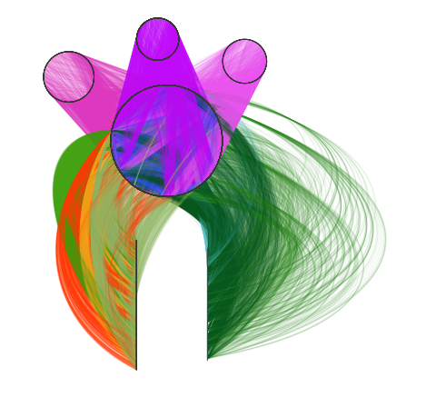
Biological process
Cellular compartment
Molecular function
genes
small
molecules
diseases

Slide 26
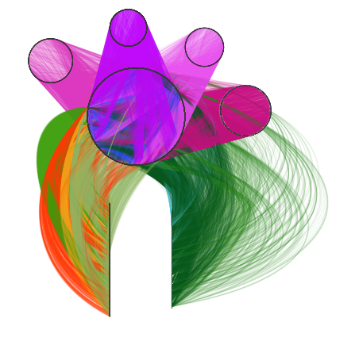
Biological process
Cellular compartment
Molecular function
Biological pathways
genes
small
molecules
diseases

Slide 27
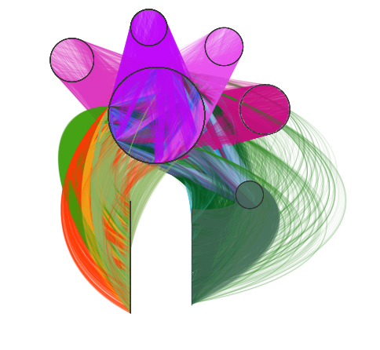
Biological process
Cellular compartment
Molecular function
Biological pathways
genes
Disease anatomies
small
molecules
diseases

Slide 28
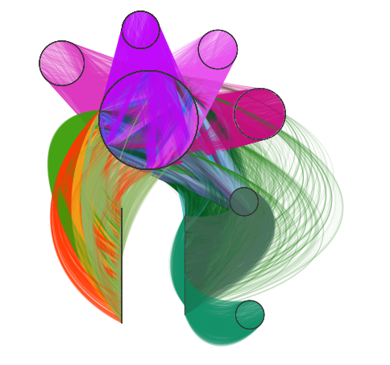
Biological process
Cellular compartment
Molecular function
Biological pathways
genes
Disease anatomies
small
molecules
diseases
symptoms

Slide 29
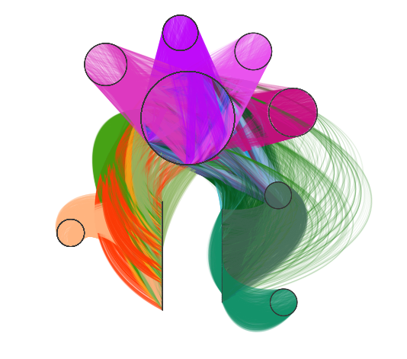
Biological process
Cellular compartment
Molecular function
Biological pathways
genes
Disease anatomies
small
molecules
diseases
Side
effects
symptoms

Slide 30
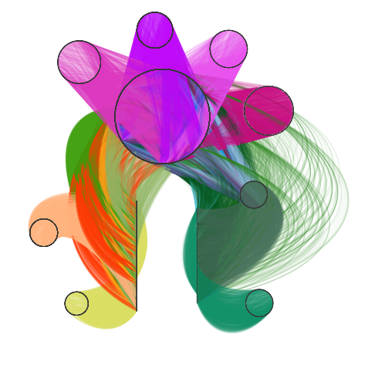
Biological process
Cellular compartment
Molecular function
Biological pathways
genes
Disease anatomies
?
small
molecules
diseases
Side
effects
symptoms
47,031 nodes (11 types)
2,250,197 relationships (24 types)

Slide 31
Hetionet v1.1 characteristics
11 node types
24 edge types

Slide 32
Pipeline summary
Created Hetionet v1.0 — an integrative network with 2,250,197 relationships of 24 types.
Extracted features from the network (to quantify the prevalence of specific path types between each compound and disease). 46.8M paths!
Fitted regularized regression model (to translate from network-based features to a probability of treatment for a given compound–disease pair).
Permuted the network (to reduce false positives)

Slide 33
Feature contribution

Slide 34
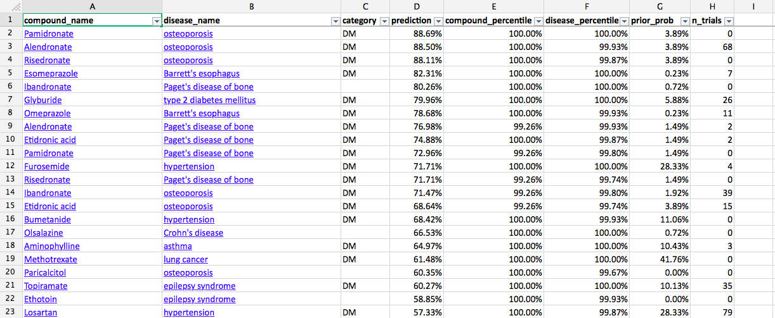
Top predictions
Between 30-300 fold increase over null!

Slide 35
Prediction Performance
100
75
Disease modifying
50
Prediction percentile rank
Drug Central
Clinical Trials
25
Symptomatic
0

Slide 36
Refining and expanding the method
Add biologics?
EMR?
Proprietary knowledge?
Metagenomics data?
Bench testing?

Slide 37
Pharm Class
Genotype
Symptom
Lab Test
Compound
Flow chart
Diagnosis
Anatomy
Disease
Medication
Gene
Microbe
KO
GO

Slide 38
-5
-6
-7
-1
0
-1
-2
-1
0
0
-2
-4
-1
-2
-1
0
0
-3
0
Network Signature for Patient i at time point j

Slide 39
3y
2m
Find hubs by clustering network signatures

Slide 41
Cytoscape Apps
jActive modules
MCODE
BINGO
GeneMANIA
PINBPA
iCTNet

Slide 42
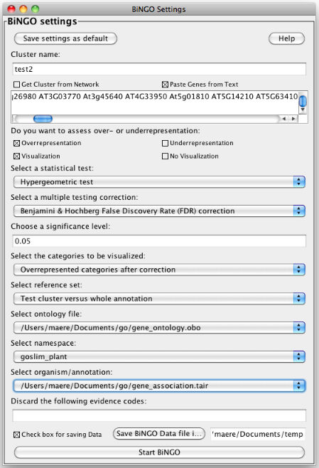
BINGO: Gene ontology analysis

Slide 43
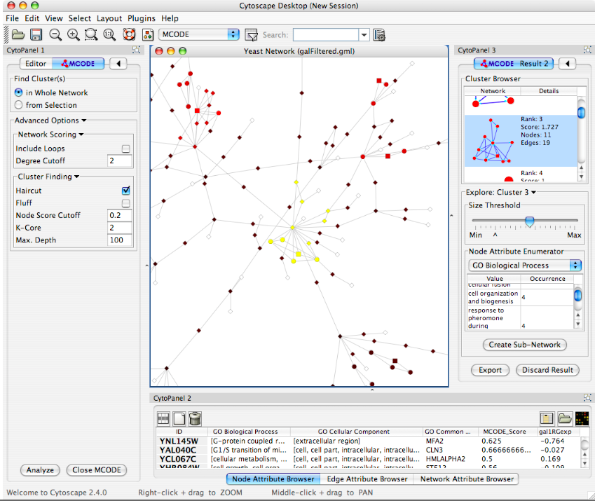
MCODE (Clusters a given network based on topology to find densely connected regions)

Slide 44
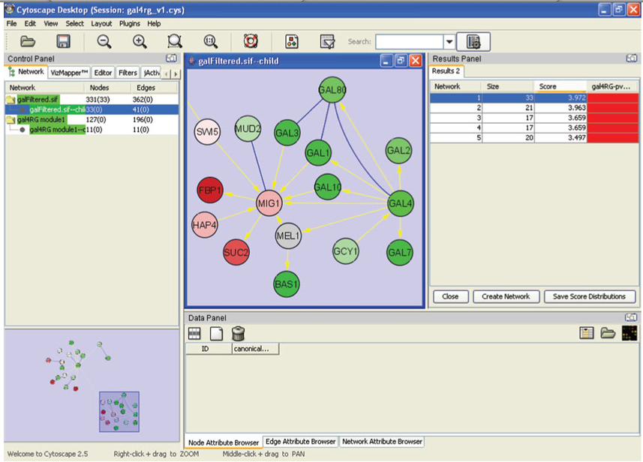
jActive modules Finds clusters where member nodes show significant changes in expression levels

Slide 45
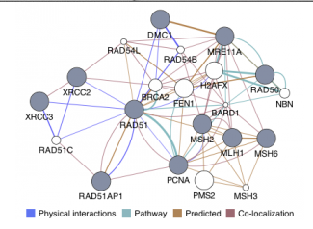
GeneMANIA Imports interaction networks from public databases from a list of genes with their annotations and putative functions.

Slide 46
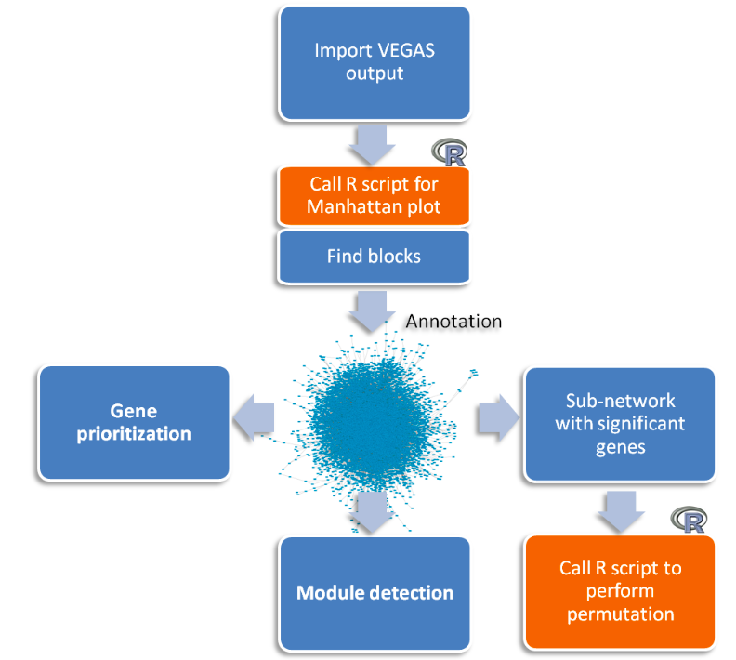
PINBPA Protein-interaction-network-based Pathway Analysis of GWAS

Slide 47
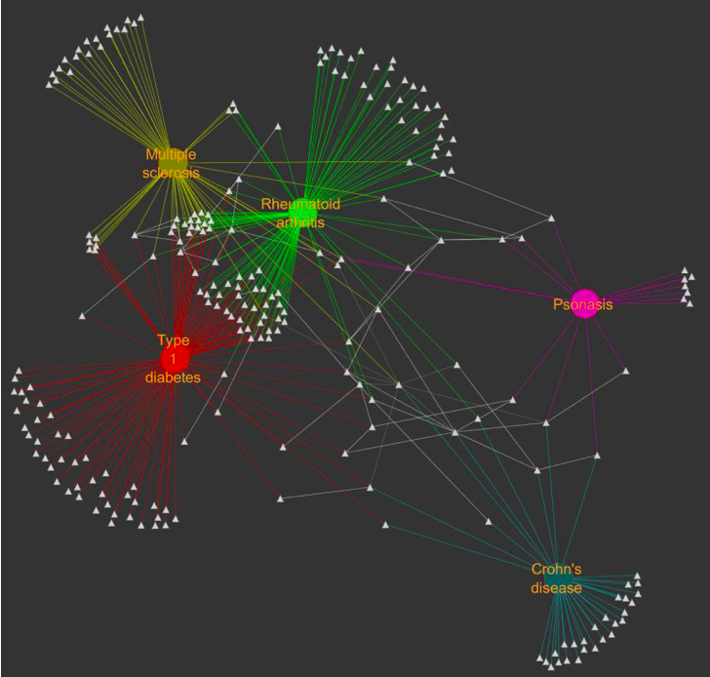
iCTNet: assembles human disease, tissue, gene and drug-target interactions

Slide 48
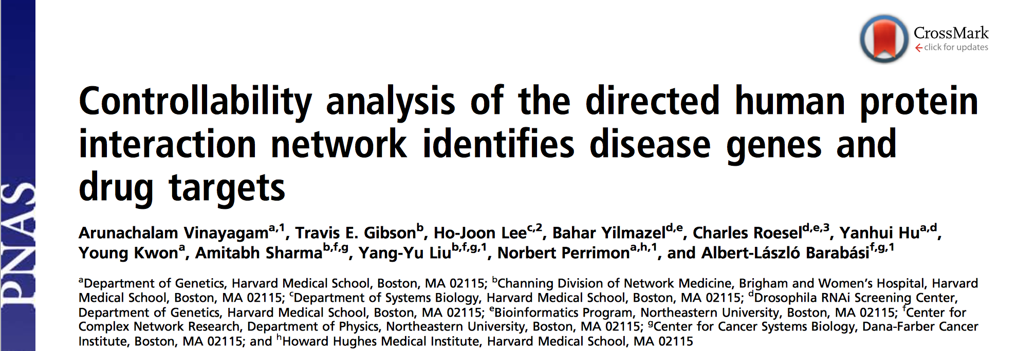
Reading assignment

