Slide 1
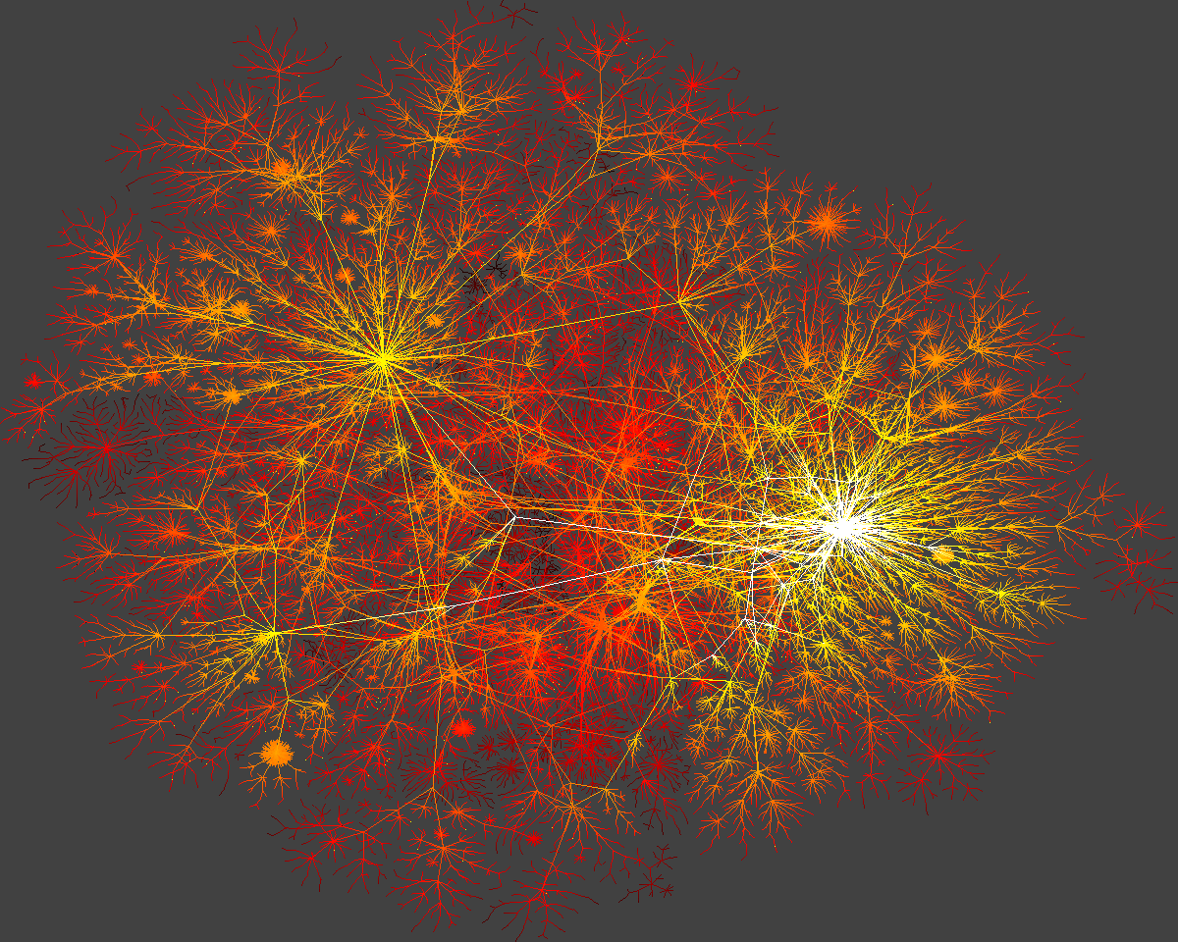
Introduction to network science
Sergio Baranzini, PhD
Department of Neurology
QB3
Program in Bioinformatics
Institute for Human Genetics
UCSF

Slide 2
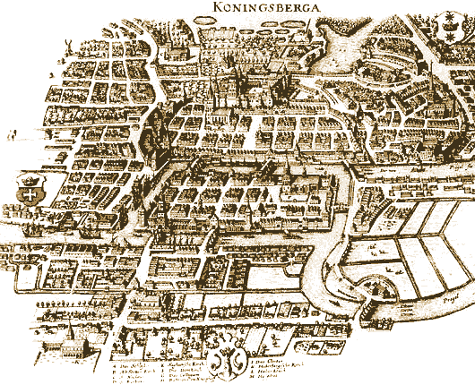
The Bridges of Konigsberg
Can one walk across the seven bridges and never cross the same bridge twice?
Notes:
Few research fields can trace their roots to a single moment and place in history. Graph theory, the mathematical scaffold behind network science, can. Its roots go back to 1736 to Konigsberg, a thriving merchant city in Eastern Prussia. Its busy fleet of ships and the trade they brought allowed city officials to build seven bridges across the river Pregel that surrounded the town. Five of these connected the elegant island Kneiphof, caught between the two branches of the Pregel, to the mainland;
two crossed the two branches of the river. This peculiar arrangement gave birth to a contemporary puzzle: Can one walk across all seven bridges and never cross the same one twice? Despite many attempts, no one could find such path. The problem remained unsolved until 1736, when Leonard Euler, a Swiss born mathematician, offered a rigorous mathematical proof that such path does not exist.

Slide 3
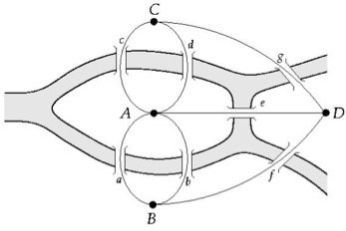
The problem as a graph
Can one walk across the seven bridges and never cross the same bridge twice?
1735: Euler’s theorem:
If a graph has more than two nodes of odd degree, there is no path.
If a graph is connected and has no odd degree nodes, it has at least one path.
Notes:
Euler's insight was to represent each of the four land areas separated by the river as nodes, distinguishing them with letters A, B, C, and D. Next he connected with lines each piece of land that had a bridge between them. He thus built a {graph}, whose {nodes} were the pieces of land and {links} were the bridges. Then Euler made a simple observation: if there is a path crossing all bridges, but never the same bridge twice, then nodes with odd number of links must be either the starting or the end point of this path. Indeed, with an odd number of links you can arrive to a node and have no unused link for you to leave it. Yet, a continuous path that goes through all bridges can have only one starting and one end point. Thus such a path cannot exist on a graph that has more than two nodes with an odd number of links. As the K\"{o}nigsberg graph had three such nodes, B, C, D, each with three links, no path could satisfy the problem.
Today we remember Euler's proof because it was the first time someone solved a mathematical problem by turning it into a graph. In hindsight the proof has two important messages:
1. Some problems become simpler and more treatable if they are represented as a graph.
2. The existence of the path does not depend on our ingenuity to find it. Rather, it is a property of the graph. Indeed, given the layout of the K\"{o}nigsberg bridges, no matter how smart we are, we will never find the desired path.
in 1875 built a new bridge between B and C, increasing the number of links of these two nodes to four
In other words, networks have properties, hidden in their structure, that affect the function of the system they describe, limiting or enhancing our ability to do things with or on them. To fully understand how networks affect the properties of a system, we need to become familiar with some basic concepts in graph theory, encountering the language and mathematical formalism that will be of direct use throughout this book.

Slide 4
Networks as complex systems
components: nodes, vertices N
interactions: links, edges L
system: network, graph (N,L)

Slide 5
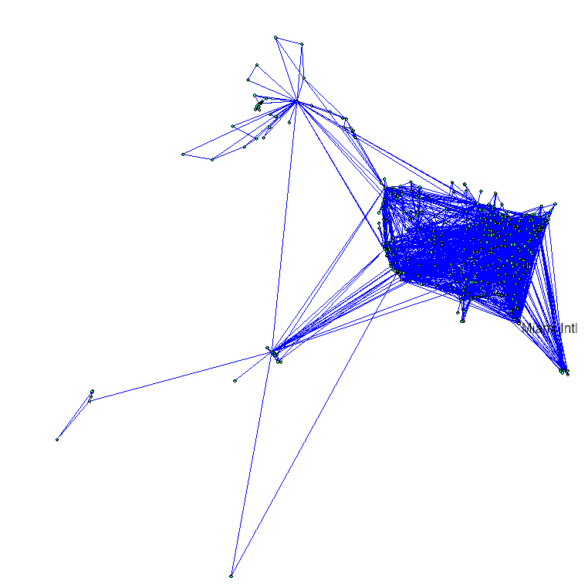
Examples of real-life networks
-connections among people
-trade among organizations, countries
Social
networks
-citation networks
-computer networks
-telephone calls
Organic molecules in chemistry
Genes and proteins in biology
Connections among words in text
Transportation (airlines, streets, electric networks, etc)

Slide 6
Types of networks
Directed vs undirected
Random vs scale-free
Homogeneous vs bi-partite vs heterogeneous

Slide 7
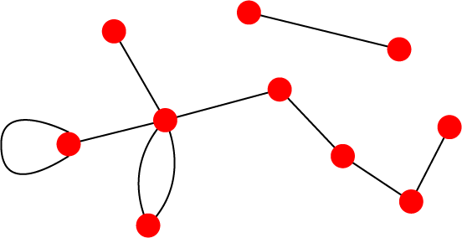
Undirected vs directed networks
Undirected
Directed
Links: undirected (symmetrical)
Graph:
Links: directed (arcs).
Digraph = directed graph:
L
A
D
F
M
B
An undirected link is the superposition of two opposite directed links.
C
I
D
B
G
E
G
H
A
C
F
Undirected links :
coauthorship links
Actor network
protein interactions
Directed links :
URLs on the www
phone calls
metabolic reactions
Network Science: Graph Theory January 24, 2011

Slide 8
Network topology metrics
Degree (k) and distribution
Path length
Clustering Coefficient
Eccentricity
Radius
Diameter
Centrality
  Closeness
  betweenness

Slide 9
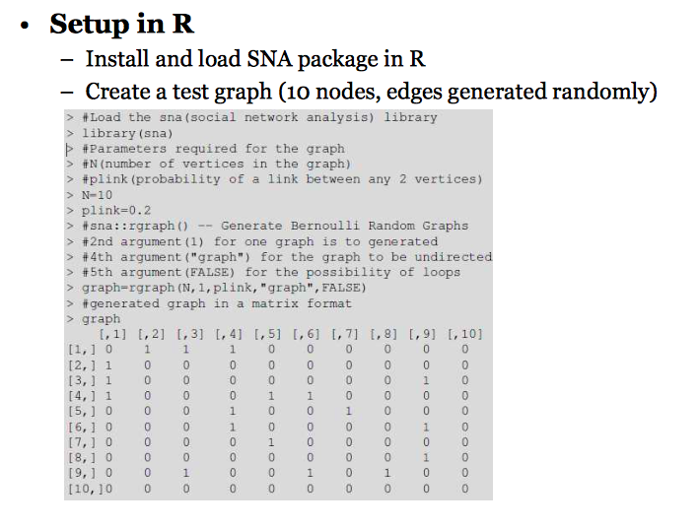
gplot (graph) for visualization

Slide 10
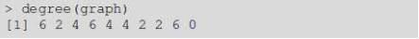
Degree
Undirected
Directed
B
B
F
F
C
C
G
G
A
E
A
E
D
D
H
H
k_{A}=5
k_{Ain}=5
k_{Aout}=1

Slide 11
Degree Distribution
B
Node
k
A
5
F
B
3
C
F
3
C
2
G
E
2
A
E
G
2
D
1
D
H

Slide 12
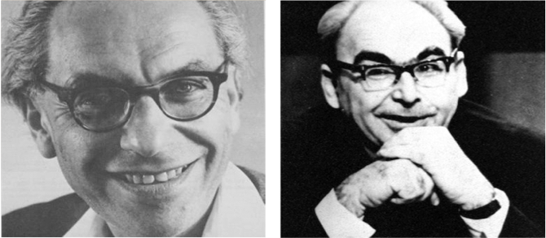
Random network model
Pál Erdös
(1913-1996)
Alfréd Rényi
(1921-1970)
Erdös-Rényi model (1960)
Connect with probability p
p=1/6 N=10
<k> ~ 1.5

Slide 13
Random vs scale-free
E-R: connectivity per node follows normal distribution
# nodes
# connections (k)
Scale-free: Connectivity per node follows power law distribution
# nodes
Log # nodes
# connections (k)
Log # connections (k)
Notes:
In a random network each node has the same probability to connect to any other in the net.
In a scale free network, there are hubs (hyperconnected nodes) but the majority are loosely connected

Slide 14
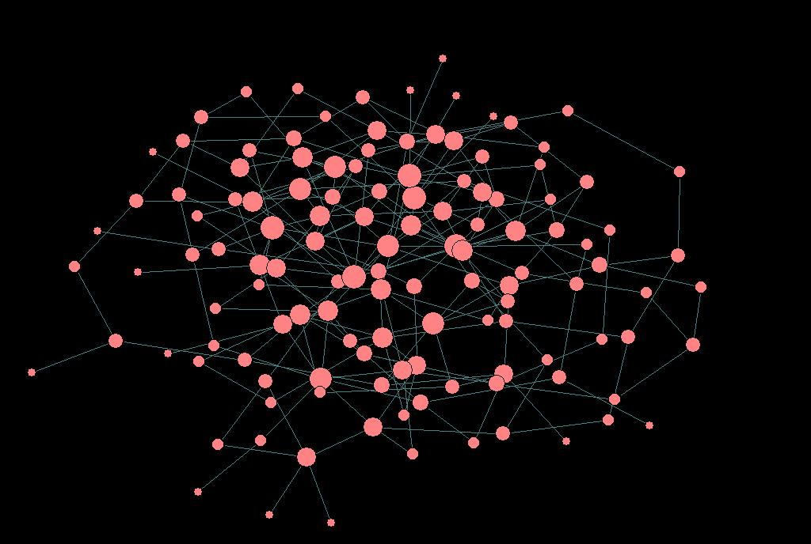
Random (E&R) network: An example

Slide 15
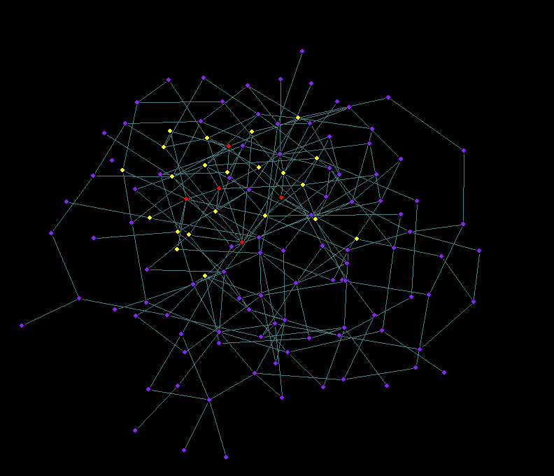
Random (E&R) network: limited reach

Slide 16
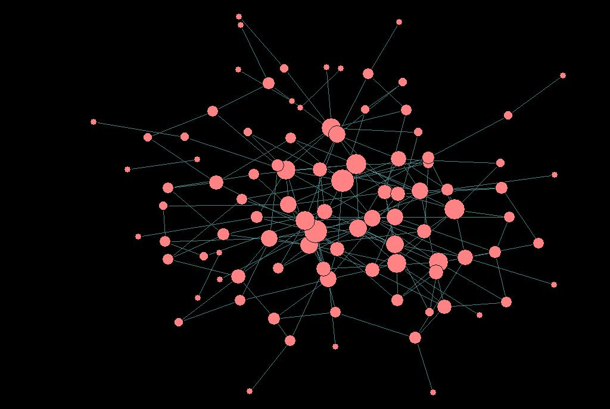
scale-free network: An example

Slide 17
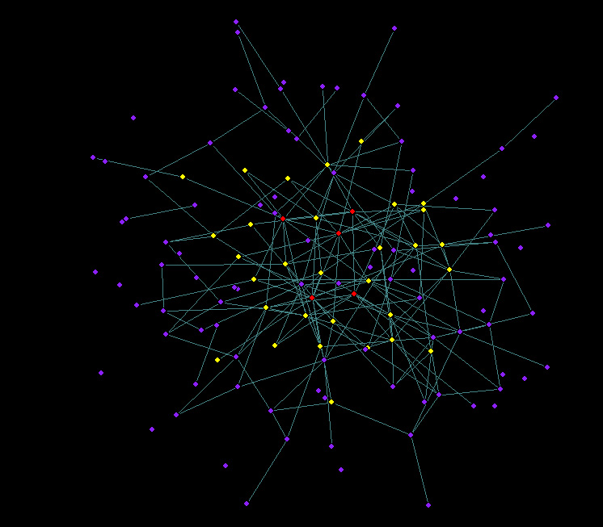
scale-free network: wider reach

Slide 18
Shortest path
Undirected
Directed
B
B
F
F
C
C
G
G
A
A
E
E
D
D
H
H
l_{AH}=1
l_{AH}=4
Notes:
Measures the navigability of the net

Slide 19
Clustering coefficient
B
F
C
G
A
E
D
H
C_{I}=2n_{I}/k(k-1)
C_{A}=2*1/5(5-1)= 0.1
Notes:
Describes the degree of modularity of the net
The number of direct edges between the first neighbors of a given node is equivalent to the number of triangles that can be drawn with that node as a vertex.

Slide 20
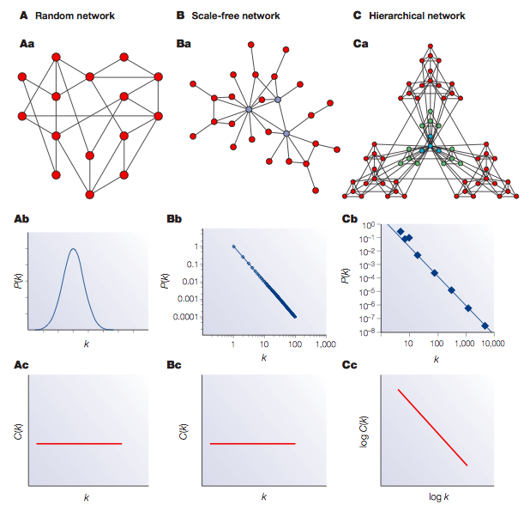
Network characterization by degree and clustering coefficient

Slide 21
Eccentricity
The eccentricity of a vertex is the greatest geodesic distance between a given node and any other node. It can be thought of as how far a node is from the node most distant from it in the graph.

Slide 22
Diameter
The diameter of a graph is the maximum eccentricity of any vertex in the graph. That is, it is the greatest distance between any pair of vertices.
To find the diameter of a graph, first find the shortest path between each pair of vertices. The greatest length of any of these paths is the diameter of the graph.

Slide 23
Radius
The radius of a graph is the minimum eccentricity of any vertex

Slide 24
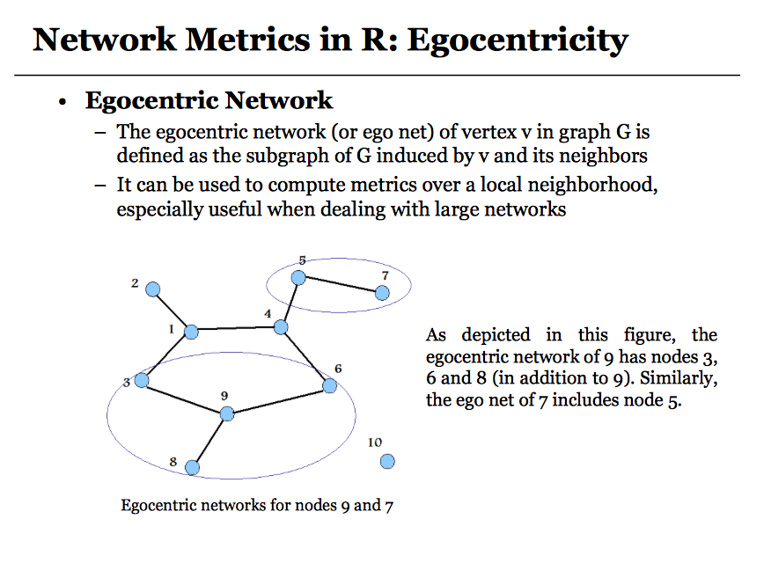

Slide 25
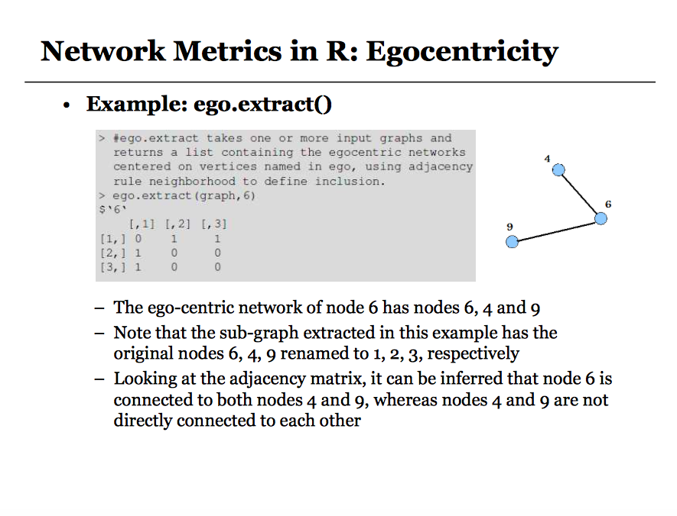

Slide 26
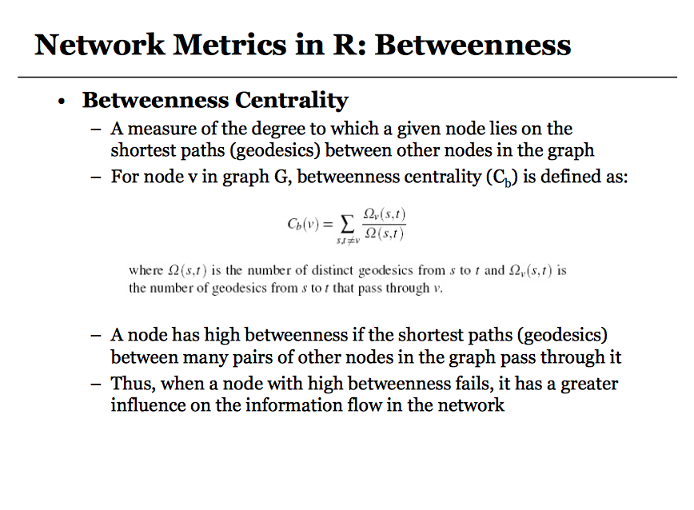
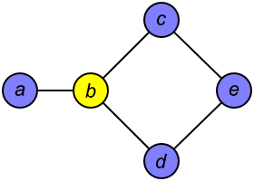

Slide 27
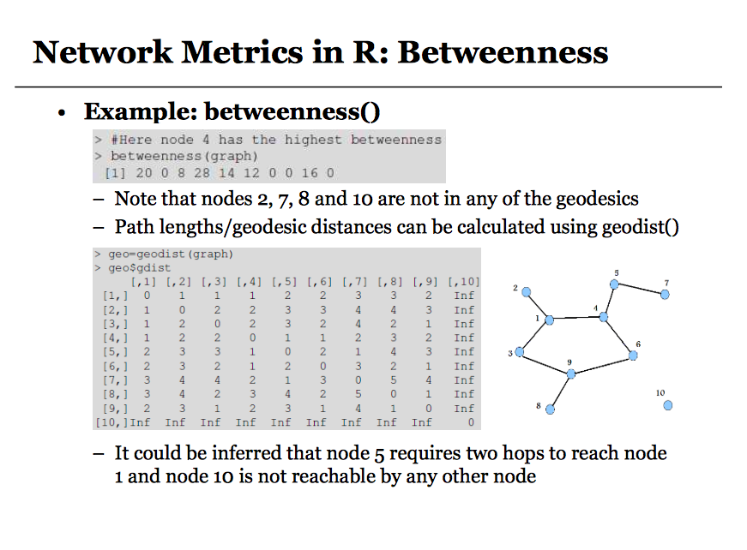

Slide 28
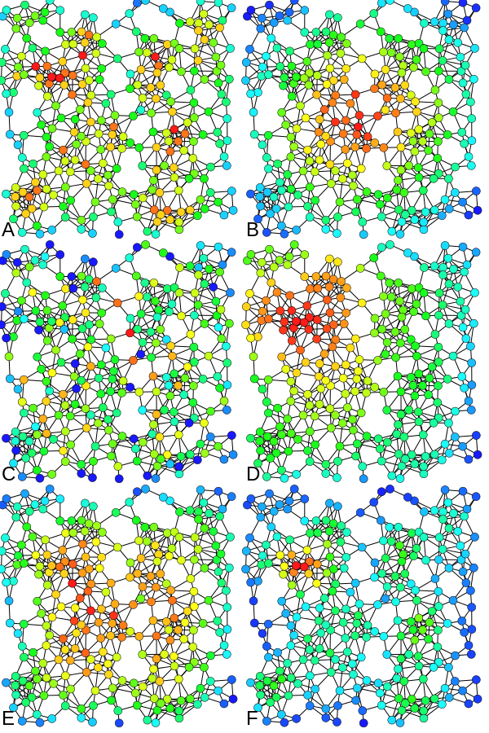
Betweenness centrality

Slide 29
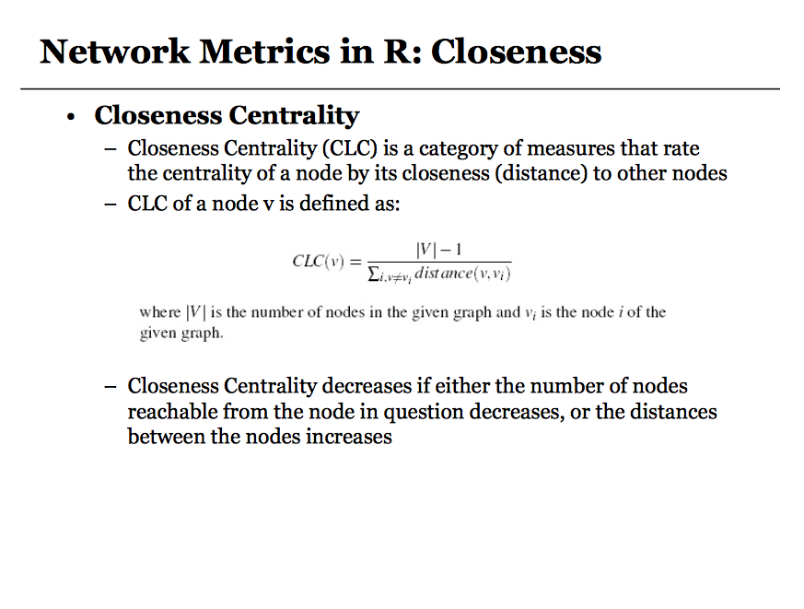

Slide 30
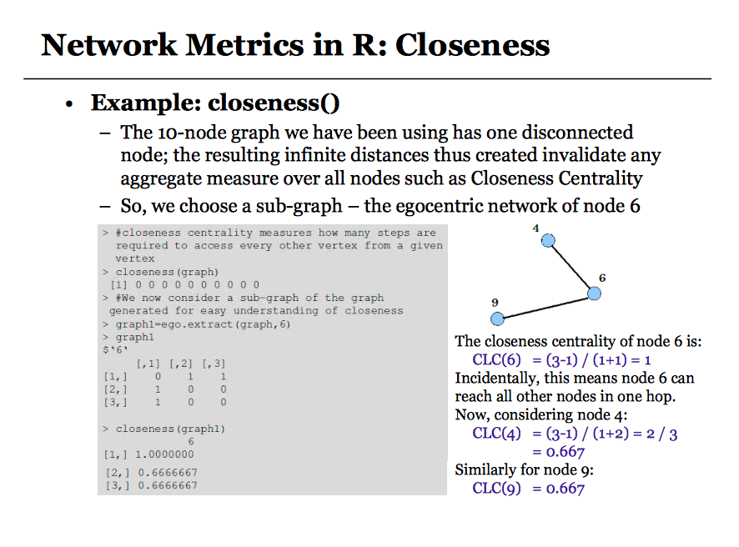

Slide 31
Closeness Centrality

Slide 32
Six degrees of separation
ADD YOUR NAME TO THE ROSTER AT THE BOTTOM OF THE SHEET. So that the next person who receives the letter will know where it came from
DETACH ONE POSTCARD. FILL IT OUT AND RETURN IT TO HARVARD UNIVERSITY. To allow us to keep track of the folder as it moves toward the target person
IF YOU KNOW THE TARGET PERSON ON PERSONAL BASIS, MAIL THIS FOLDER DIRECTLY TO HIS/HER.
IF YOU DO NOT KNOW THE TARGET PERSON, MAIL THIS FOLDER TO A PERSONAL ACQUAINTANCE WHO IS MORE LIKELY THAN YOU TO KNOW THE TARGET PERSON
Milgram’s experiment
Milgram, S (1967). Psychol. Today, 2, 60-67)
Notes:
Milgram wanted to know what were the characteristics of social networks (acquaintances)
All follow power laws!!

Slide 33

SIX DEGREES 1991: John Guare
"Everybody on this planet is separated by only six other people. Six degrees of separation. Between us and everybody else on this planet. The president of the United States. A gondolier in Venice…. It's not just the big names. It's anyone. A native in a rain forest. A Tierra del Fuegan. An Eskimo. I am bound to everyone on this planet by a trail of six people. It's a profound thought. How every person is a new door, opening up into other worlds."
Network Science: Random Graphs January 31, 2011
Notes:
The phrase was invented by the playwright John Guare, who used it as the title of his Broadway play writer in 1991, that was eventually turned into a movie with the same title. In the play the lead character, Ousa, musing about our interconnectedness, tells her daughter:

Slide 34
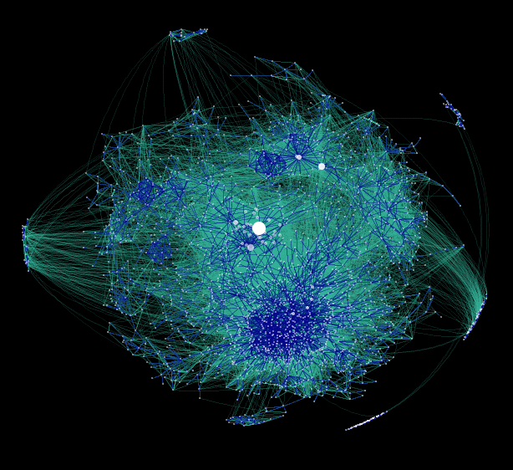
WWW: 19 DEGREES OF SEPARATION
Image by Matthew Hurst
Blogosphere
Network Science: Random Graphs January 31, 2011

Slide 35
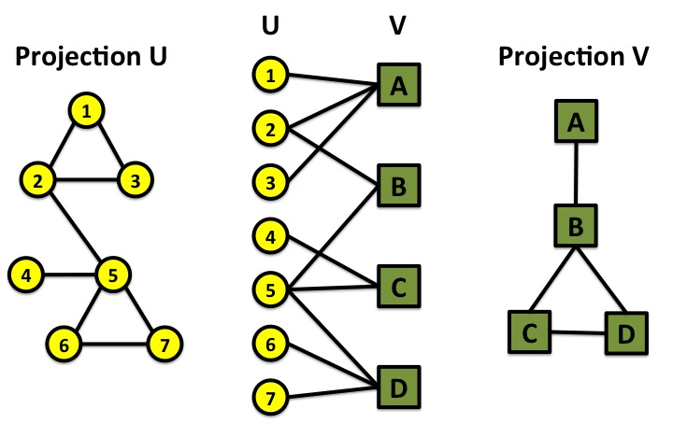
Bi-partite networks
bipartite graph (or bigraph) is a graph whose nodes can be divided into two disjoint sets U and V such that every link connects a node in U to one in V; that is, U and V are independent sets.
Examples:
Hollywood actor network
Collaboration networks
Disease network (diseasome)
Network Science: Graph Theory January 24, 2011

Slide 36
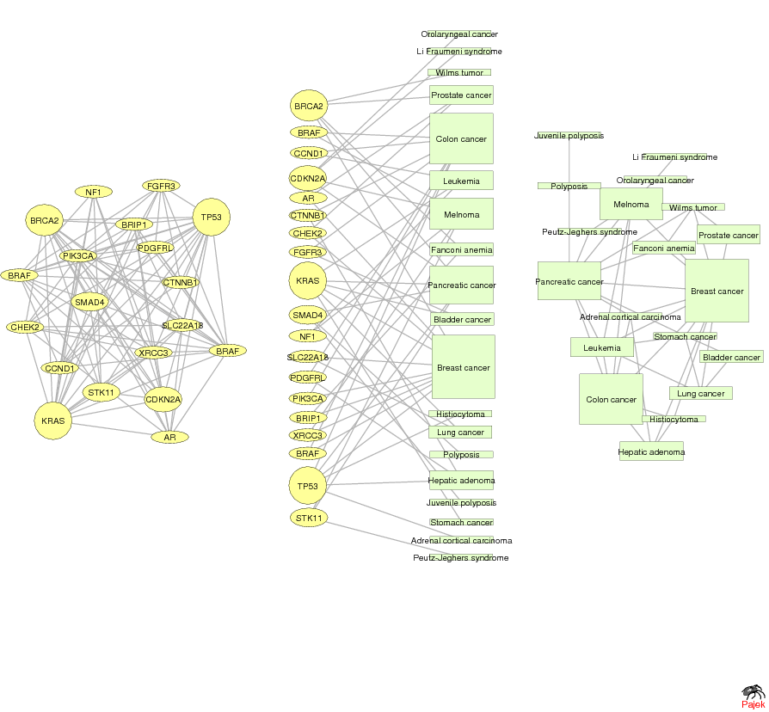
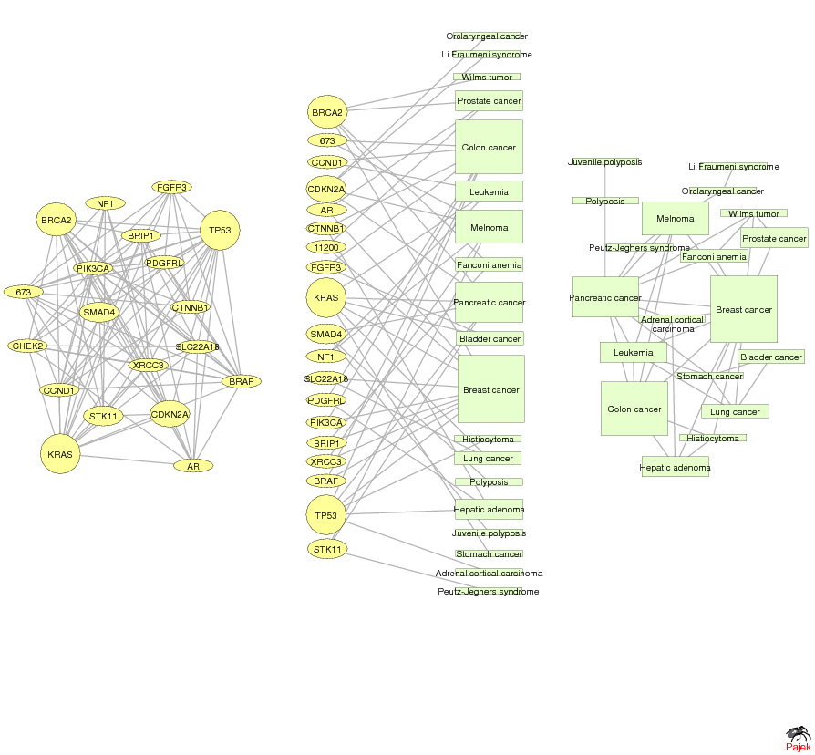
GENE NETWORK – DISEASE NETWORK
DISEASOME
PHENOME
GENOME
Gene network
Disease network
Goh, Cusick, Valle, Childs, Vidal & Barabási, PNAS (2007)
Network Science: Graph Theory January 24, 2011

Slide 37
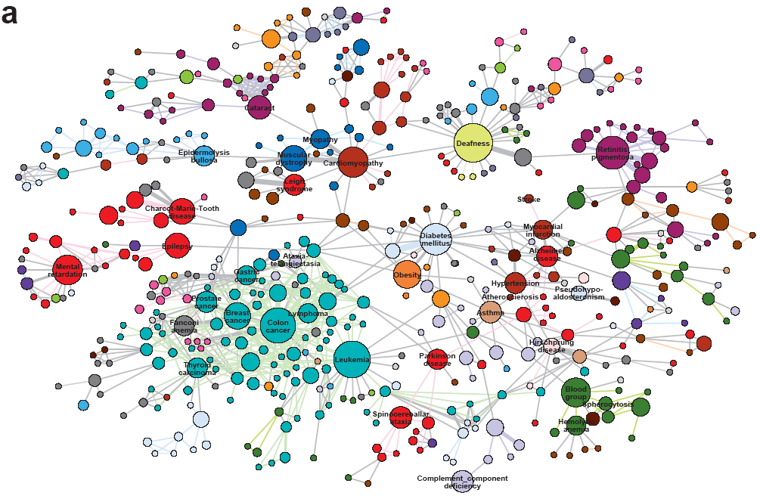
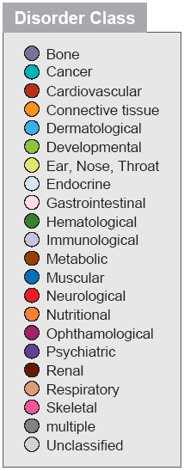
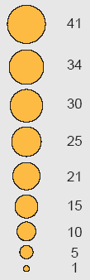
The diseasome

Slide 38
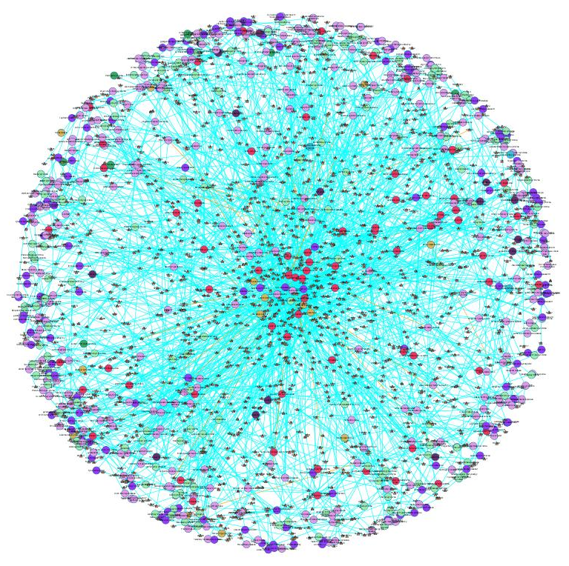
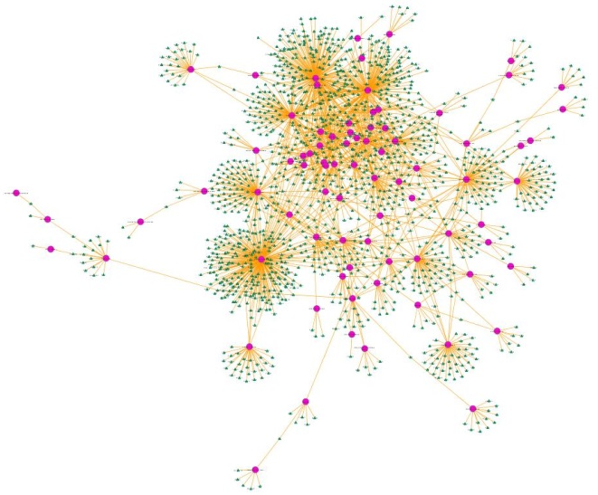
OMIM
GWAS
1547 nodes
2010 edges
Ratio N/E= 0.77
2265 nodes
2228 edges
Ratio N/E= 1.01

Slide 39
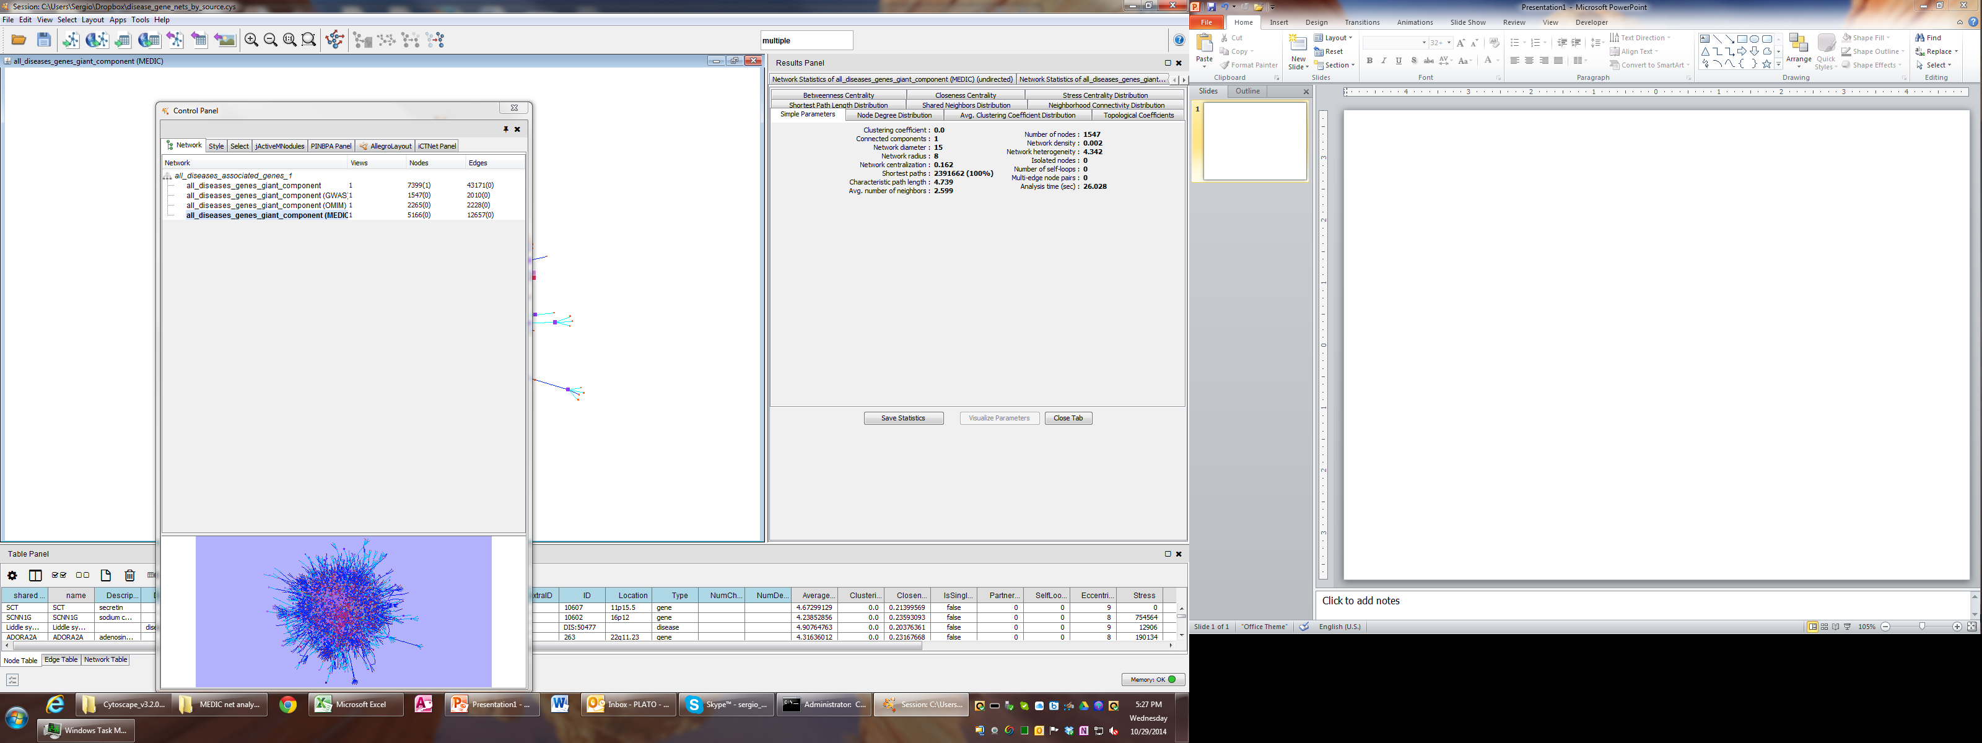
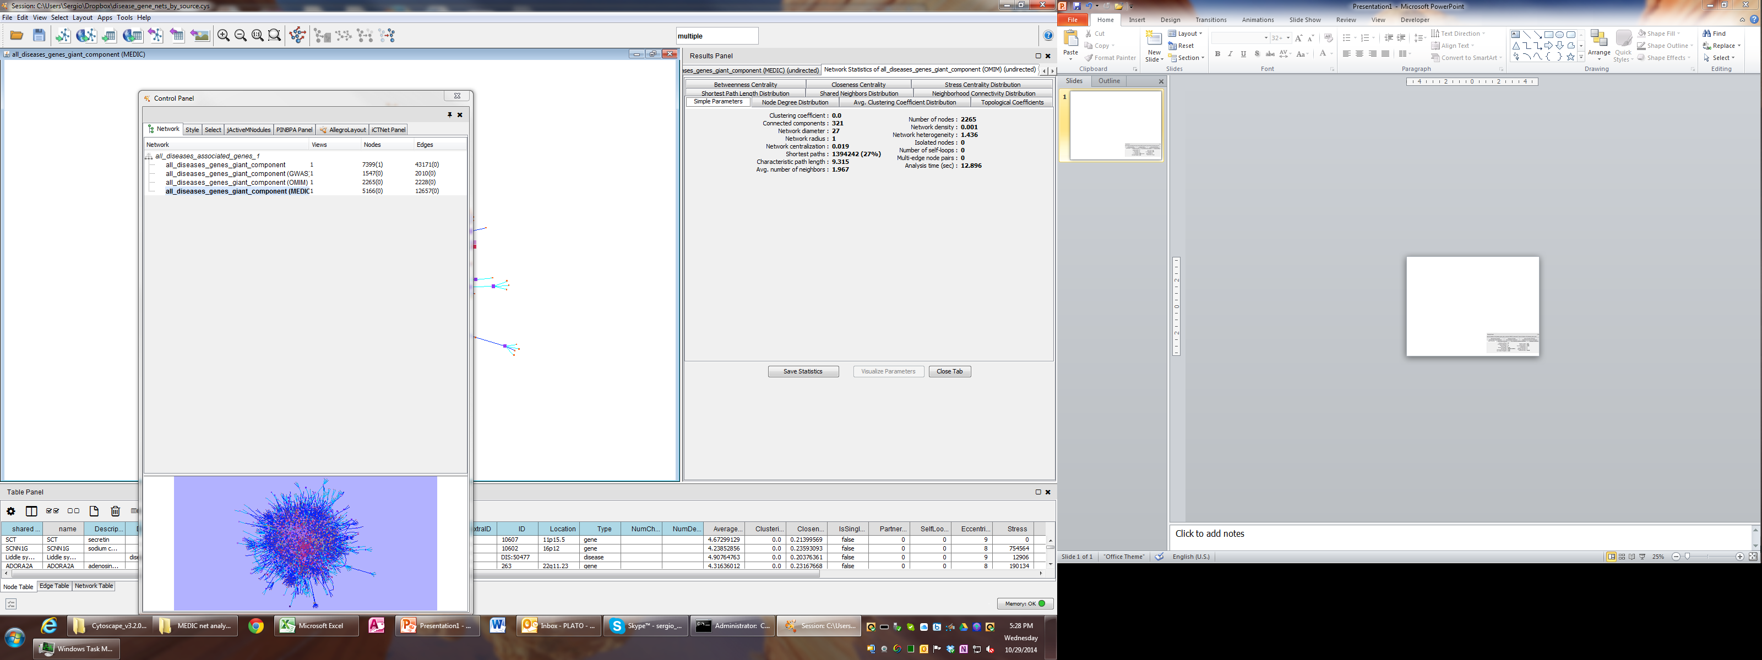
Summary network statistics
GWAS
OMIM

Slide 40
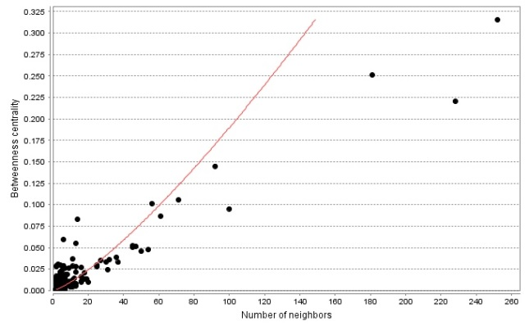
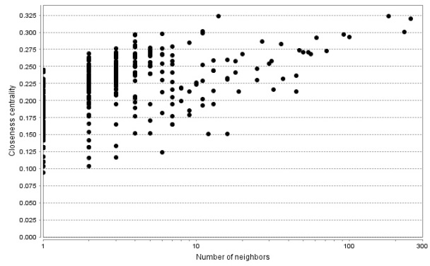
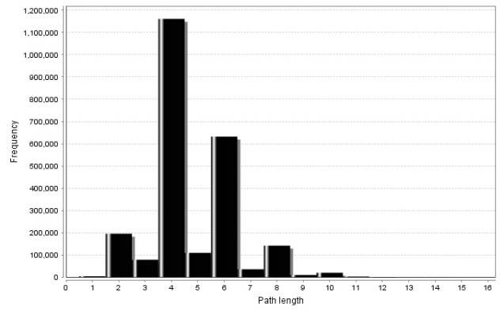
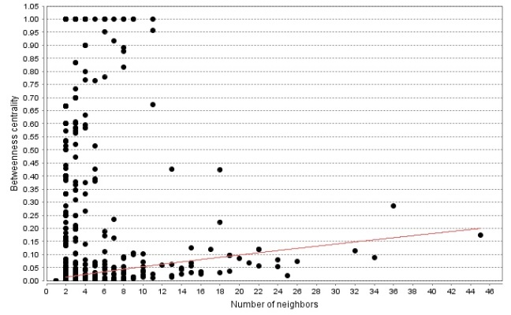
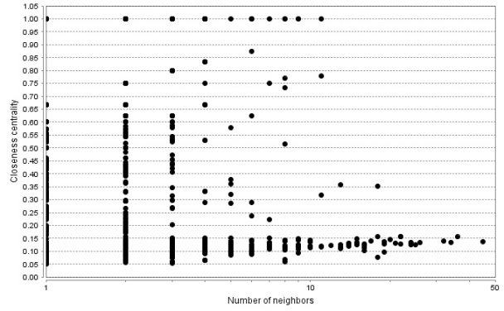
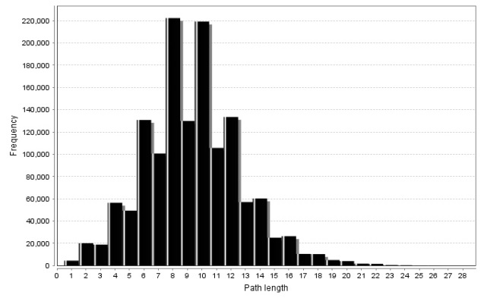

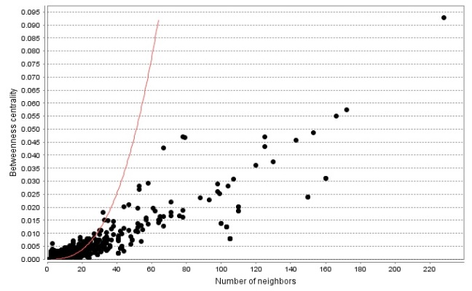
Betweeness centrality
Closeness centrality
Shortest path length distribution
GWAS
OMIM

Slide 41
ROBUSTNESS IN COMPLEX SYSTEMS
Complex systems maintain their basic functions even under errors and failures
Cell → mutations
There are uncountable number of mutations and other errors in our cells, yet, we do not notice their consequences.
Internet → router breakdowns
At any moment hundreds of routers on the internet are broken, yet, the internet as a whole does not loose its functionality.
Where does robustness come from?
There are feedback loops in most complex systems that keep tab on the component’s and the system’s ‘health’.
Could the network structure affect a system’s robustness?

Slide 42
Attack threshold for arbitrary P(k)
Attack problem: we remove a fraction f of the hubs.
At what threshold f_{c} will the network fall apart (no giant component)?
Hub removal changes
the maximum degree of the network [K_{max} → K’_{max} ≤K_{max})
the degree distribution [P(k) → P’(k’)]
A node with degree k will loose some links because some of its neighbors will vanish.
Cohen et al., Phys. Rev. Lett. 85, 4626 (2000).

Slide 43
Random (E&R) network: limited reach

Slide 44
scale-free network: wider reach

Slide 45
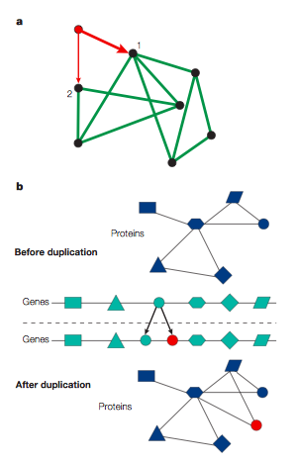
Evolution of scale-free networks
1. duplication
2. Preferential attachment

Slide 46
Google page rank: an example of preferential attachment
Preferential attachment will favor older nodes (e.g. journal article citations). Early journal articles on a given topic more likely to be cited. Once cited, this material is more likely to be cited again in new articles, so original articles in a field have a higher likelihood of becoming hubs in a network of references.
The Google search engine (PageRank) interprets a link from page A to page B as a vote, by page A, for page B. It also analyzes the page that casts the vote. Votes cast by pages that are themselves "important" weigh more heavily and help to make other pages "important”.

Slide 47
Useful links on networks
http://barabasilab.neu.edu/courses/phys5116/
http://math.nist.gov/~RPozo/complex_datasets.html
http://www2.econ.iastate.edu/tesfatsi/netgroup.htm
http://www.visualcomplexity.com/vc/about.cfm
http://necsi.edu/publications/dcs/
http://cnets.indiana.edu

